Slide 1


Optimization Algorithms
Lecture 5: Simulated Annealing
Alaa Khamis, Ph.D
AI and Smart Mobility Professor at KFUPM and Ex- GM Technical Leader
This lecture is based on Part-II Trajectory-based Algorithms of the textbook: Optimization Algorithms: AI techniques for design, planning, and control problems, Manning Publication, 2024.
2025 © Dr. Alaa Khamis

Slide 2
Outline
Metaheuristics Algorithms
Physical Annealing
Simulated Annealing (SA)
SA Cooling Schedule
Adaptation in SA
NetLogo Model
Function Optimization
Solving Sudoku
Solving TSP
Solving Delivery Semi-Truck Routing Problem
SA for PLP
SA for Scheduling Problems
Notes:
2

Slide 3
Outline
Metaheuristics Algorithms
Physical Annealing
Simulated Annealing (SA)
SA Cooling Schedule
Adaptation in SA
NetLogo Model
Function Optimization
Solving Sudoku
Solving TSP
Solving Delivery Semi-Truck Routing Problem
SA for PLP
SA for Scheduling Problems
Notes:
3

Slide 4
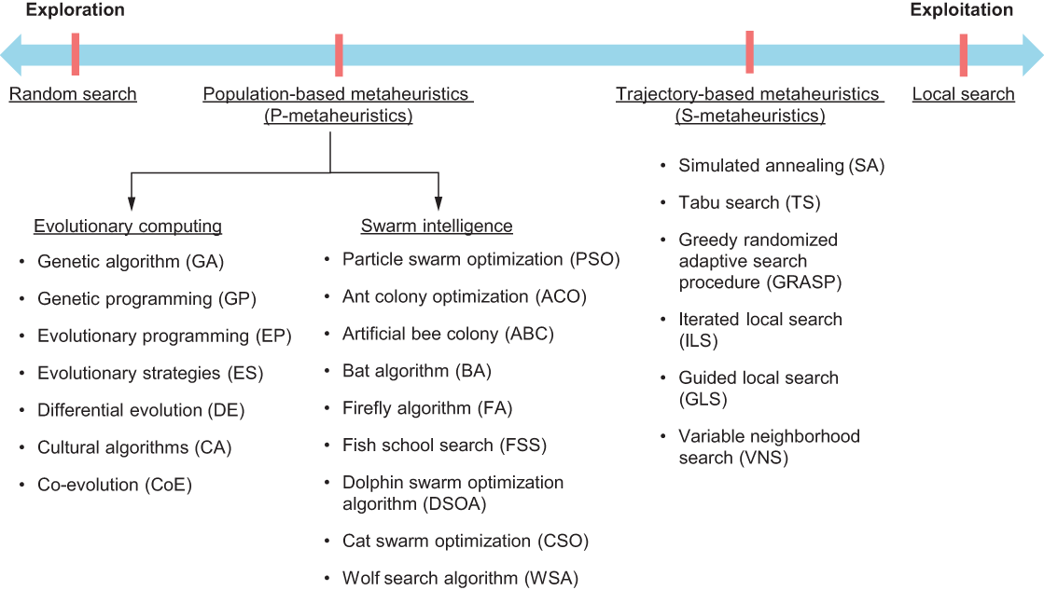
Metaheuristics Algorithms

Slide 5
Outline
Metaheuristics Algorithms
Physical Annealing
Simulated Annealing (SA)
SA Cooling Schedule
Adaptation in SA
NetLogo Model
Function Optimization
Solving Sudoku
Solving TSP
Solving Delivery Semi-Truck Routing Problem
SA for PLP
SA for Scheduling Problems
Notes:
5

Slide 6

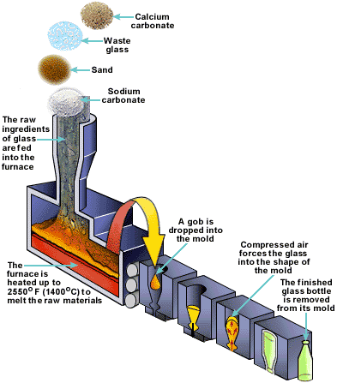
Physical Annealing
Physical Annealing process has been used since 5000 B.C. and mainly used in glass bottle making and crystals.
https://www.youtube.com/watch?v=JMGkbrETU8M

Slide 7
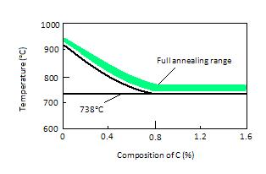
Physical Annealing
Annealing is a heat treatment wherein a material is altered, causing changes in its properties such as strength and hardness.
It is a process that produces conditions by heating to above the recrystallization temperature and maintaining a suitable temperature, and then cooling

Slide 8
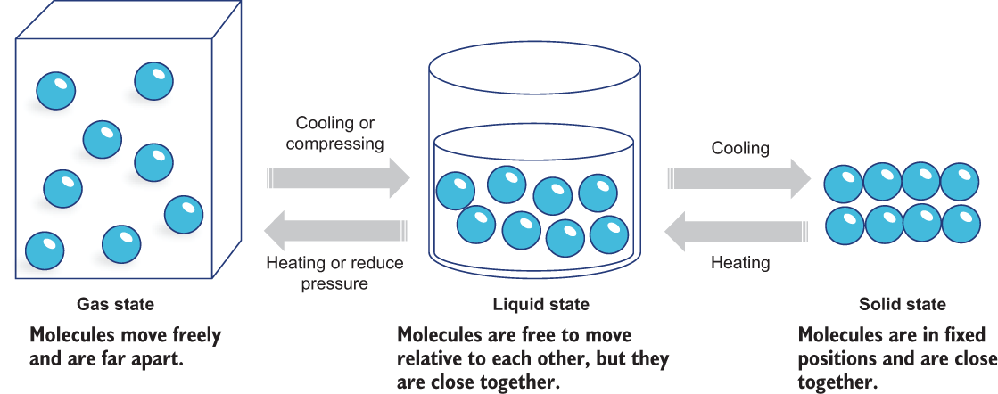
Physical Annealing
As temperature reduces, the mobility of molecules reduces, with the tendency that molecules may align themselves in a crystalline structure. The aligned structure is the minimum energy state for the system.

Slide 9
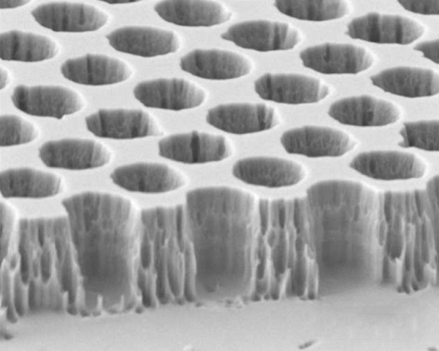
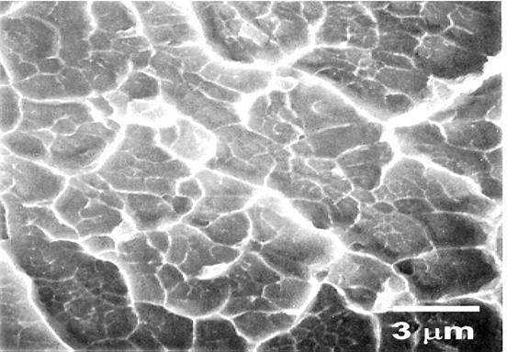
Physical Annealing
To ensure that this alignment is obtained, cooling must occur at a sufficiently slow rate.
If the substance is cooled at a too rapid rate, an amorphous state may be reached.
A metal with crystalline structure
Amorphous metal with a disordered atomic scale structure

Slide 10
Outline
Metaheuristics Algorithms
Physical Annealing
Simulated Annealing (SA)
SA Cooling Schedule
Adaptation in SA
NetLogo Model
Function Optimization
Solving Sudoku
Solving TSP
Solving Delivery Semi-Truck Routing Problem
SA for PLP
SA for Scheduling Problems
Notes:
10

Slide 11
Simulated Annealing (SA)
The first SA algorithm was developed in 1953 (Metropolis).
Kirkpatrick (1982) applied SA to optimization problems.
It was used for locating a good approximation of the global optimum in large search spaces.
Applications
Non-linear function optimization Travelling Salesman Problem (TSP) Academic course scheduling Network design Task allocation | Constraint Satisfaction Problems Circuit partitioning and placement Strategy scheduling for capital products with complex product structure Umpire scheduling in US Open Tennis tournament! and more…

Slide 12
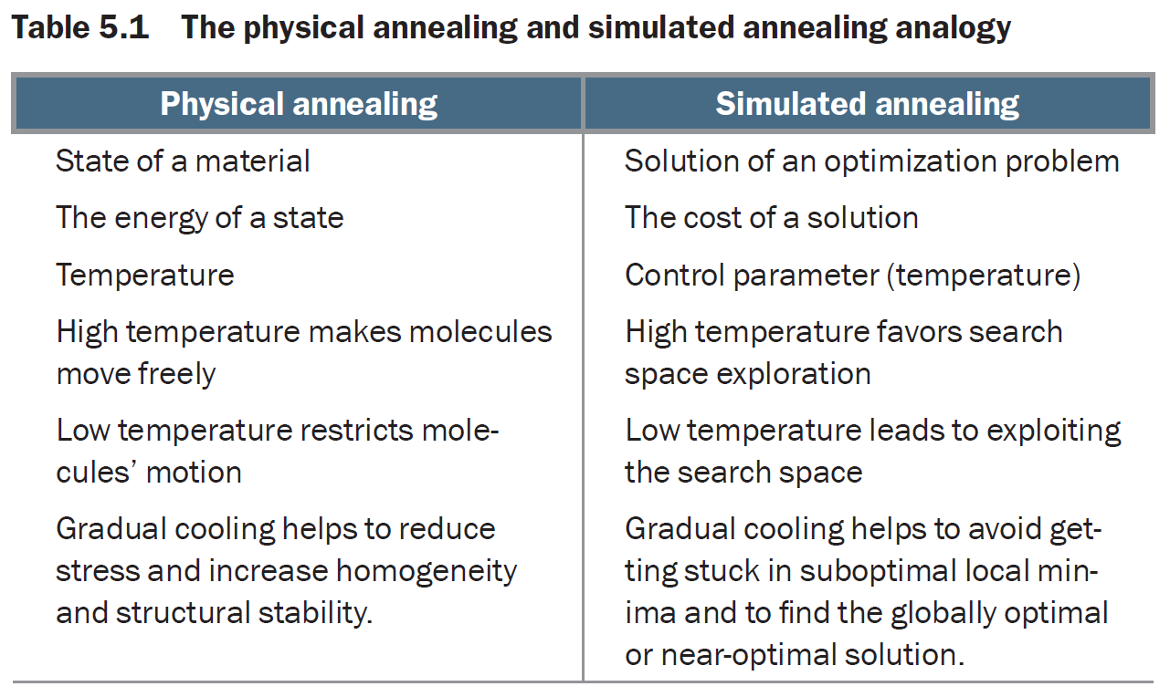
Simulated Annealing (SA)

Slide 13
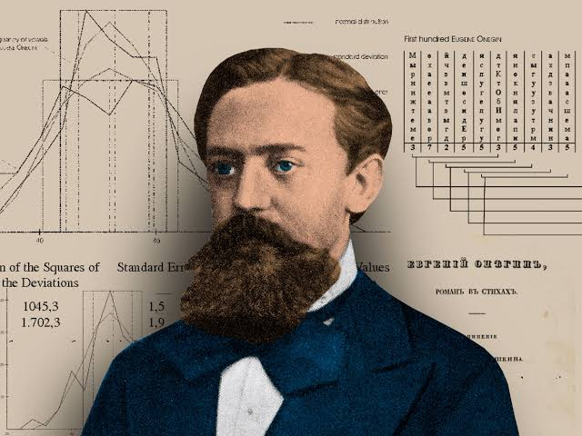
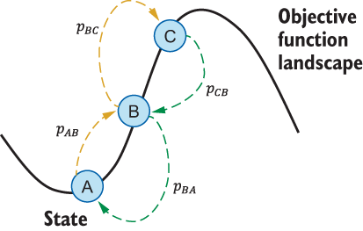
Simulated Annealing (SA)
SA employs a Markov chain-based random search approach, which not only accepts new solutions that decrease the objective function (assuming a minimization problem) but can also accept probabilistic solutions that increase objective function values.
Markov chain is a memoryless random process. This means that the next state depends only on the current state and not on the sequence of events that preceded it.
Russian mathematician Andrey Markov (1856–1922)
Past
Present
Future
Future is independent of the past given the present. However, past can be used for learning or prediction.

Slide 14
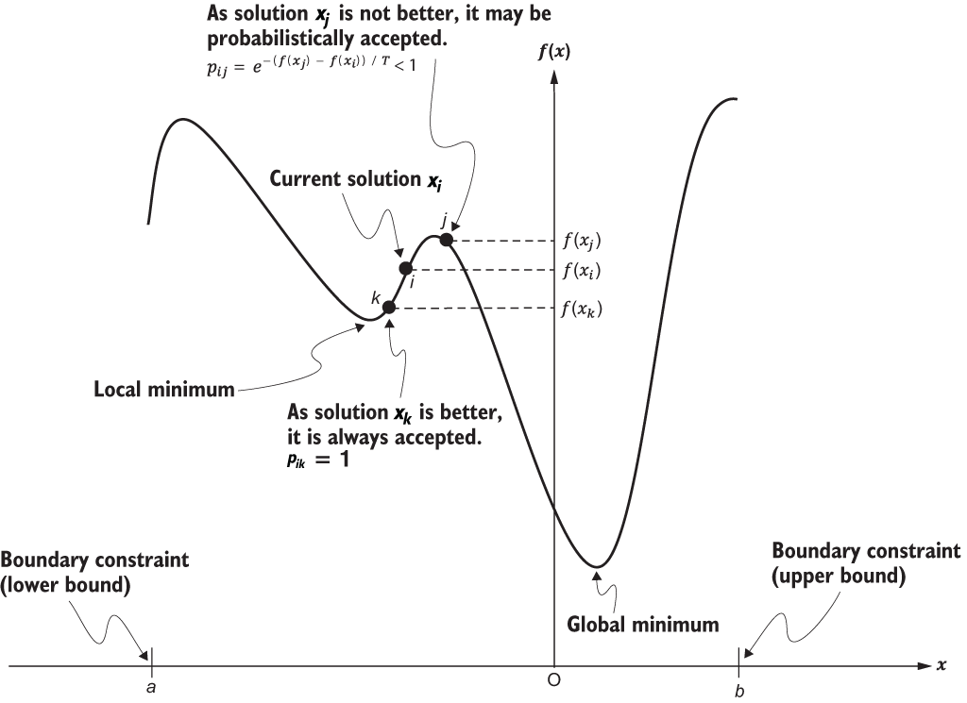
Simulated Annealing (SA)
SA uses a random search strategy, which not only accepts new positions that decrease the objective function (assuming a minimization problem) but also accepts positions that increase objective function values.

Slide 15
Simulated Annealing (SA)
To accept or not to accept?
In thermodynamics, a state at a temperature t has a probability of an increase in the energy magnitude ΔE given by Boltzmann–Gibbs distribution as follows:
where k is the Boltzman constant.

Slide 16
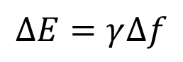
Simulated Annealing (SA)
To accept or not to accept?
The simplest way to link $∆E$ with the change of the objective function $∆f$is to use:
$$∆E=γ∆f$$
where γ is a real constant.
For simplicity without losing generality, we can use k=1 and γ=1.
Thus, the probability p simply becomes:
Whether or not we accept a change, we usually use a random number r in the interval [0,1] as a threshold.
Thus, if p > r or
the move is accepted.

Slide 17
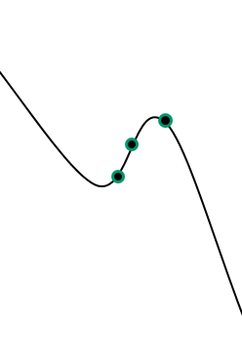
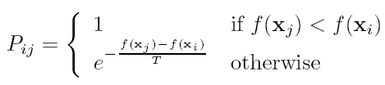
Simulated Annealing (SA)
To accept or not to accept?
If P_{ij} is the probability of moving from point x_{i} to x_{j},
then P_{ij} is calculated using:
P_{ij}<1
X_{j}
X_{i}
X_{j}
P_{ij}=1
where T is the temperature of the system.
The probability P_{ij} is called transition probability.
Simulated annealing = stochastic hill climbing with dynamic parameter T

Slide 18
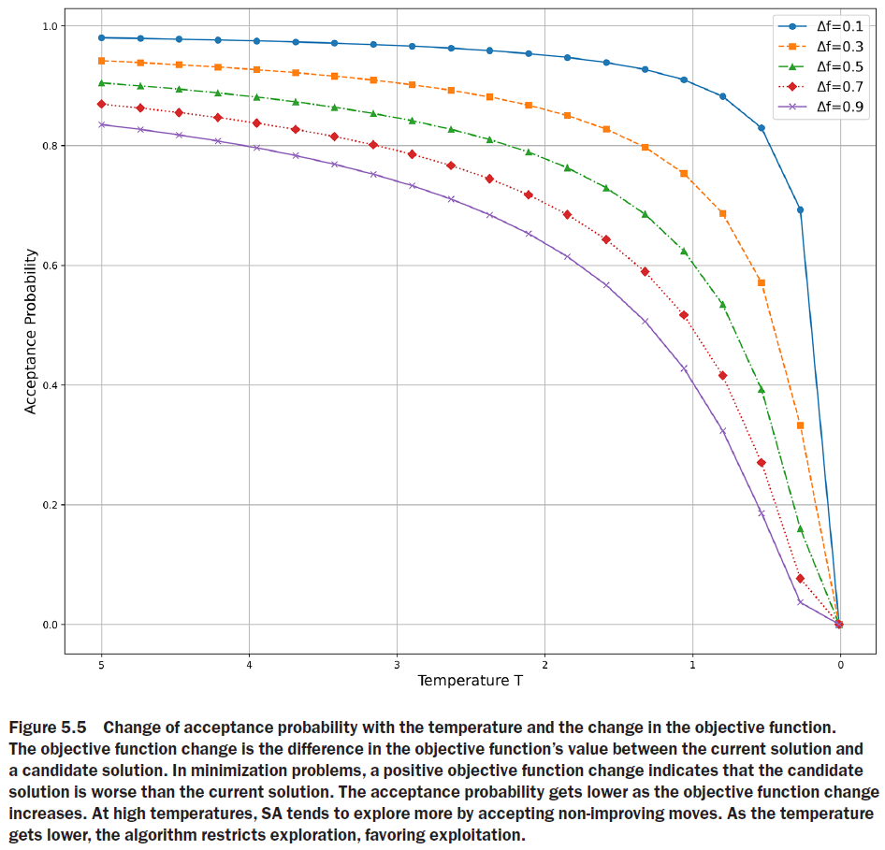
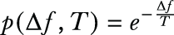
Simulated Annealing (SA)
To accept or not to accept?
The probability of accepting a worse state is a function of both the temperature of the system and the change in the cost function.
As the temperature decreases, the probability of accepting worse moves decreases.
Q: When is SA converted into hill climbing?
A: If T=0, no worse moves are accepted.

Slide 19
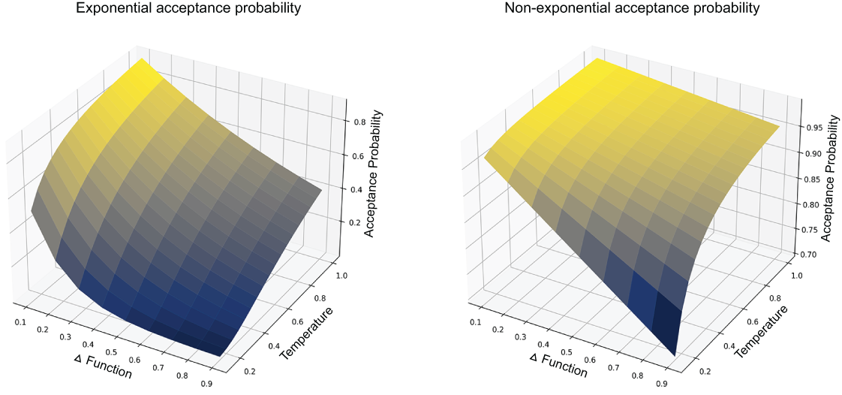
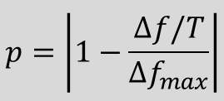
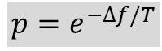
Simulated Annealing (SA)
To accept or not to accept?
$$p=e^{−∆f/T}$$
$$p=\left|1−\frac{∆f/T}{{∆f}_{max}}\right|$$

Slide 20
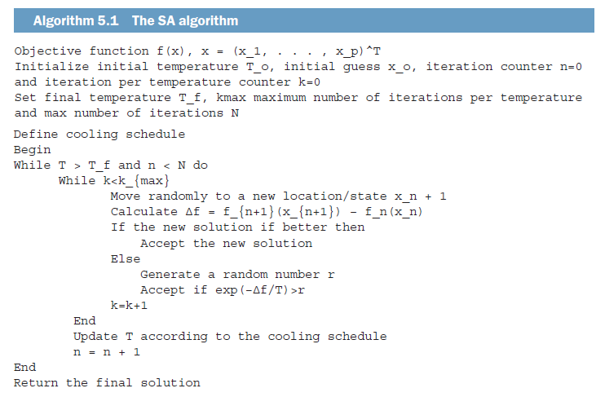
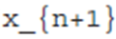
Simulated Annealing (SA)
SA Algorithm

Slide 21
Outline
Metaheuristics Algorithms
Physical Annealing
Simulated Annealing (SA)
SA Cooling Schedule
Adaptation in SA
NetLogo Model
Function Optimization
Solving Sudoku
Solving TSP
Solving Delivery Semi-Truck Routing Problem
SA for PLP
SA for Scheduling Problems
Notes:
21

Slide 22
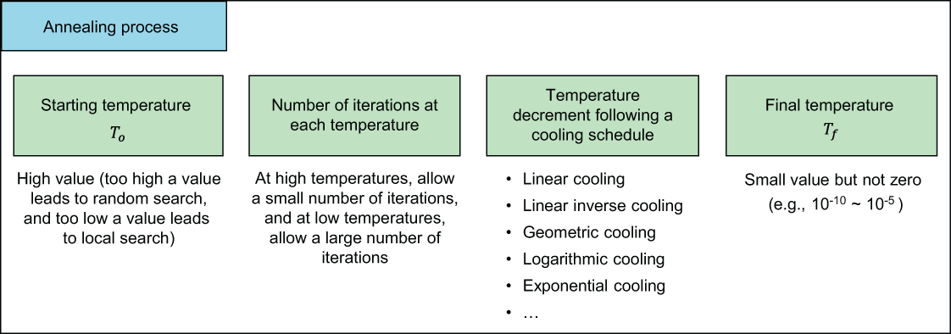
SA Cooling Schedule

Slide 23
SA Cooling Schedule
Starting Temperature
The choice of the right initial temperature is crucially important.
For a given change Δf, if T is too high (T → ∞), then p → 1, which means almost all the changes will be accepted.
If T is too low (T → 0), then any Δf > 0 (worse solution) will rarely be accepted as p → 0 and thus the diversity of the solution is limited, but any improvement Δf will almost always be accepted (may be trapped in local minima).

Slide 24
SA Cooling Schedule
Starting Temperature
In order to find a suitable starting temperature T_{o}, we can use any available information about the objective function.
If we know the maximum change max(Δf ) of the objective function, we can use this to estimate an initial temperature T_{o} for a given probability p_{o}.

Slide 25
SA Cooling Schedule
Starting Temperature
If we do not know the possible maximum change of the objective function, we can use a heuristic approach.
We can:
start evaluations from a very high temperature (so that almost all changes are accepted) and
reduce the temperature quickly until about 50% or 60% of the worse moves are accepted, and
then use this temperature as the new initial temperature T_{o} for proper and relatively slow cooling processing.

Slide 26
SA Cooling Schedule
Temperature Decrement or Annealing Schedule
Two commonly used annealing schedules (or cooling schedules) are:
Linear cooling schedule:
where T_{o} is the initial temperature, and
i is the pseudo time for iterations,
β is the cooling rate, and it should be chosen in such a way that
T → 0 when i → i_{f} (or the maximum number N of iterations), this usually gives:

Slide 27
SA Cooling Schedule
Temperature Decrement or Annealing Schedule
Geometric cooling schedule:
A geometric cooling schedule essentially decreases the temperature by a cooling factor 0 < α < 1 so that T is replaced by αT or
The cooling process should be slow enough to allow the system to stabilize easily.
In practice, α = 0.7 ~ 0.95 is commonly used.
The higher the value of α, the longer it will take to reach the final (low) temperature.

Slide 28
SA Cooling Schedule
Temperature Decrement or Annealing Schedule
Linear vs. Geometric cooling
Linear Cooling:
Geometric Cooling:
The advantage of the geometric method is that:
T → 0 when i → ∞, and thus there is no need to specify the maximum number of iterations.

Slide 29
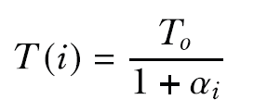
SA Cooling Schedule
Temperature Decrement or Annealing Schedule
Linear-inverse cooling schedule
In linear-inverse cooling, the temperature decreases quickly at high temperatures and more gradually at low temperatures according to the following equation:
where, α is the cooling factor and should be between 0 and 1.

Slide 30
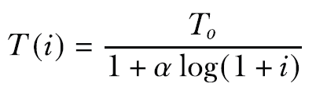
SA Cooling Schedule
Temperature Decrement or Annealing Schedule
Logarithmic cooling schedule
In this cooling schedule, the temperature is decreased logarithmically according to the following equation:
where α > 1. Theoretically, this cooling process asymptotically converges toward the global minimum. However, it requires prohibitive computing time.

Slide 31
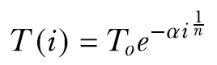
SA Cooling Schedule
Temperature Decrement or Annealing Schedule
Exponential cooling schedule
In this cooling schedule, the temperature is decreased exponentially according to the following equation:
where α is the cooling factor and n is the dimensionality of the model space. In this cooling process, the temperature is decreased very quickly during the first iterations, but the speed of the exponential decay is slowed down later and can be controlled using the cooling factor.

Slide 32
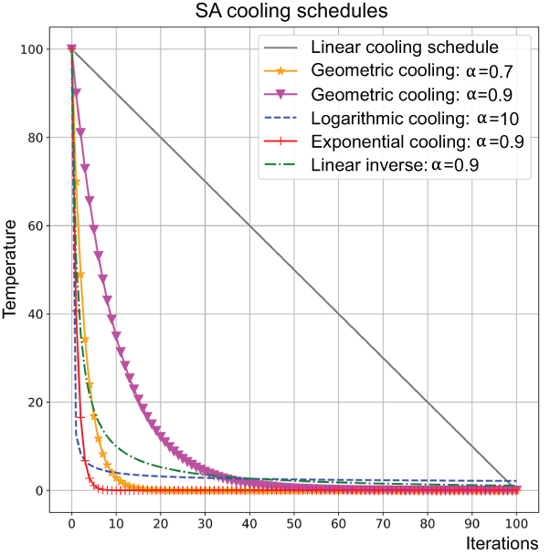
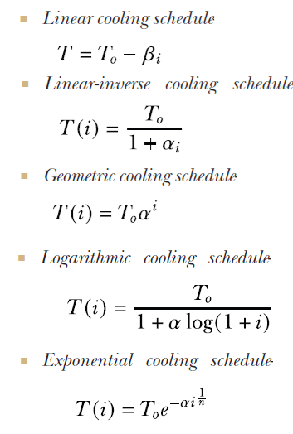
SA Cooling Schedule
Temperature Decrement or Annealing Schedule

Slide 33
SA Cooling Schedule
Iterations at each temperature
Enough iterations should be allowed at every temperature for the system to be stable at that temperature.
The required number of iterations might be exponential to the problem size.
Usually, a constant value is used.
We could dynamically change this value:
Allowing a small number of iterations at high temperatures
Allowing a large number of iterations at low temperature to fully explore the local optimum.

Slide 34
SA Cooling Schedule
Final Temperature
It is usual to let the temperature decrease until it reaches zero However, this can make the algorithm run for a lot longer, especially when a geometric cooling schedule is being used.
In practise, it is not necessary to let the temperature reach zero because the chances of accepting a worse move are almost the same as the temperature being equal to zero.
Therefore, the stopping criteria can either:
be a suitably low temperature (T_{f} = 10⁻¹⁰ ~ 10⁻⁵) or
when the system is “frozen” at the current temperature (i.e. no better or worse moves are being accepted).

Slide 35
Outline
Metaheuristics Algorithms
Physical Annealing
Simulated Annealing (SA)
SA Cooling Schedule
Adaptation in SA
NetLogo Model
Function Optimization
Solving Sudoku
Solving TSP
Solving Delivery Semi-Truck Routing Problem
SA for PLP
SA for Scheduling Problems
Notes:
35

Slide 36
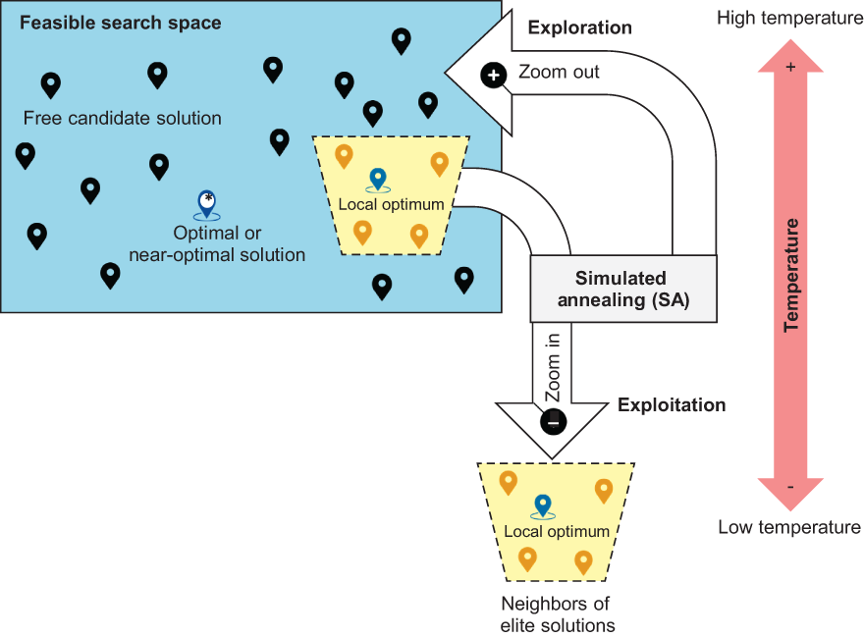
Adaptation in SA
Effect of temperature
High temperatures result in more exploration and low temperature restricts the exploration and leads to more exploitation in the search space.

Slide 37
Adaptation in SA
Number of iterations at each temperature
At high temperatures, allow a small number of iterations, and at low temperatures, allow a large number of iterations.

Slide 38
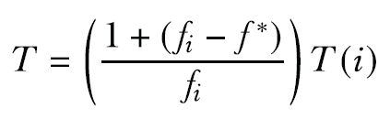
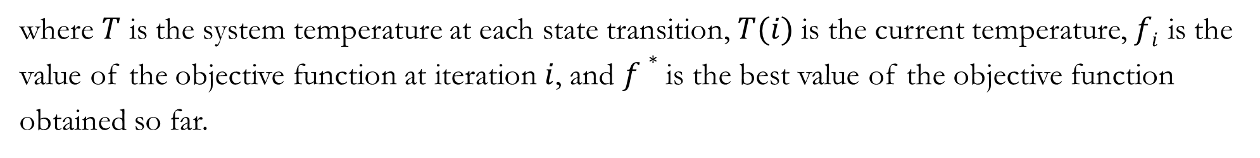
Adaptation in SA
Cooling Schedules
Different cooling schedules can be used in different phases of the search, taking into consideration that most useful work is done in the middle of the schedule. Reheating can also be tried if no progress is observed. Cooling may take place every time a move (or a specific number of moves) is accepted. A nonmonotonic adaptive cooling schedule can be tried, where an adaptive factor is used, based on the difference between the current solution objective and the best objective achieved by the algorithm up to that moment, according to the following formula:
where $T$ is the system temperature at each state transition, $T(i)$is the current temperature, $fi$ is the value of the objective function at iteration $i$, and $f∗$ is the best value of the objective function obtained so far.

Slide 39
Outline
Metaheuristics Algorithms
Physical Annealing
Simulated Annealing (SA)
SA Cooling Schedule
Adaptation in SA
NetLogo Model
Function Optimization
Solving Sudoku
Solving TSP
Solving Delivery Semi-Truck Routing Problem
SA for PLP
SA for Scheduling Problems
Notes:
39

Slide 40
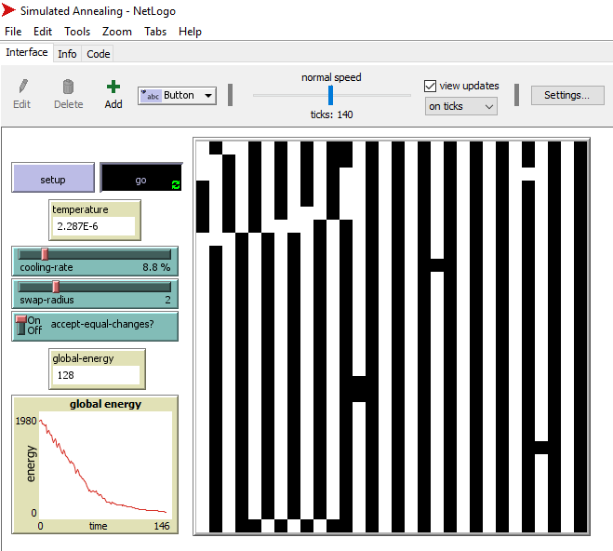
NetLogo Model
https://ccl.northwestern.edu/netlogo/models/SimulatedAnnealing

Slide 41
Outline
Metaheuristics Algorithms
Physical Annealing
Simulated Annealing (SA)
SA Cooling Schedule
Adaptation in SA
NetLogo Model
Function Optimization
Solving Sudoku
Solving TSP
Solving Delivery Semi-Truck Routing Problem
SA for PLP
SA for Scheduling Problems
Notes:
41

Slide 42
Function Optimization
find x which minimizes f(x) = (x – 6)²,
subject to the constraint 0 ≤ x ≤ 31
Assume that:
the initial temperature T₀ = 5,
the number of iterations per temperature is 2, and
the geometric cooling factor α = 0.85.
Let’s carry out a few hand iterations to show how SA can solve this problem.

Slide 43
Function Optimization
Initialization: Initial Solution
We can start with an initial random solution from the range of x. Different neighboring solutions can be generated by adding a random floating value chosen from a Gaussian or normal distribution with a given mean and standard deviation
import random
mu, sigma = 0, 1 # mean and standard deviation
print(random.gauss(mu, sigma))
An initial solution is randomly generated, and its cost is evaluated
as follows: x = 2 and f(2) = 16.

Slide 44
Function Optimization
Interation-1
A new solution $x$ = 2.25 is generated by adding a random value from a Gaussian distribution using the following code:
import numpy as np
x=x+np.random.normal(mu, sigma, 1)
$f$(2.25) = 14.06 is an improving solution and so is accepted.

Slide 45
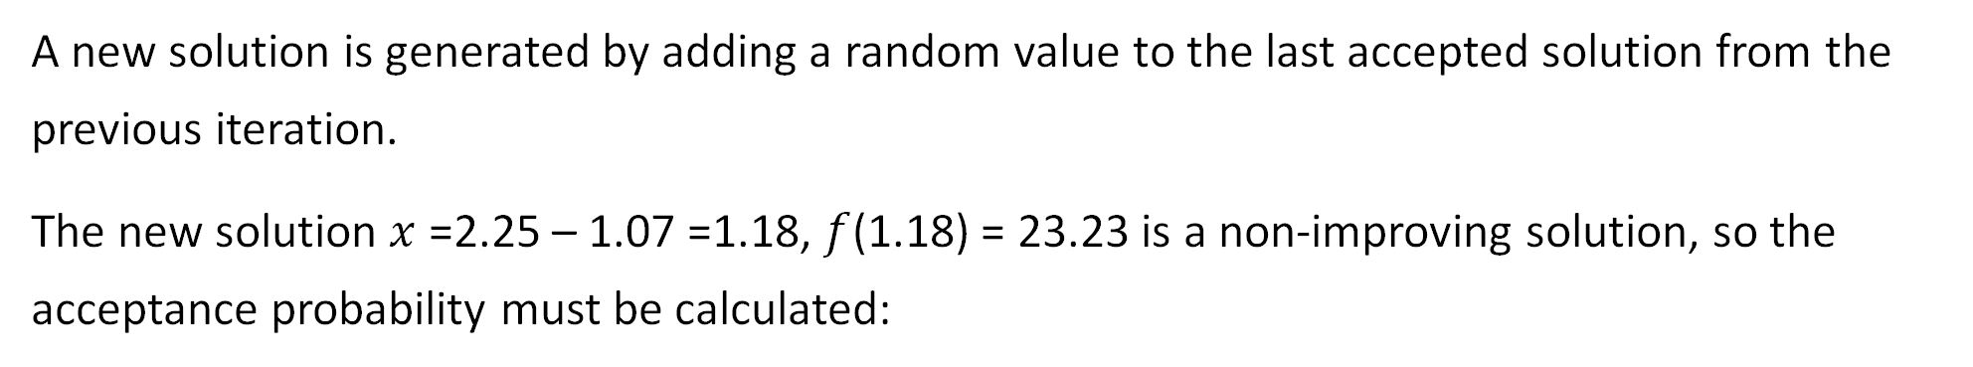
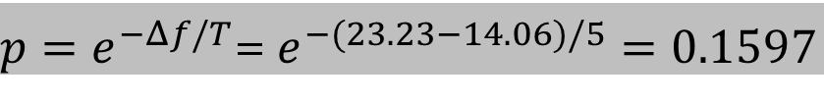
Function Optimization
Interation-2
A new solution is generated by adding a random value to the last accepted solution from the previous iteration.
The new solution $x$ =2.25 – 1.07 =1.18, $f$(1.18) = 23.23 is a non-improving solution, so the acceptance probability must be calculated:
$p=e^{−Δf/T}$= $e^{−(23.23−14.06)/5}=0.1597$
We generate a random number $r$between (0,1), and let’s say it was $r$= 0.37. As $p ≯ r$, we reject this solution.

Slide 46
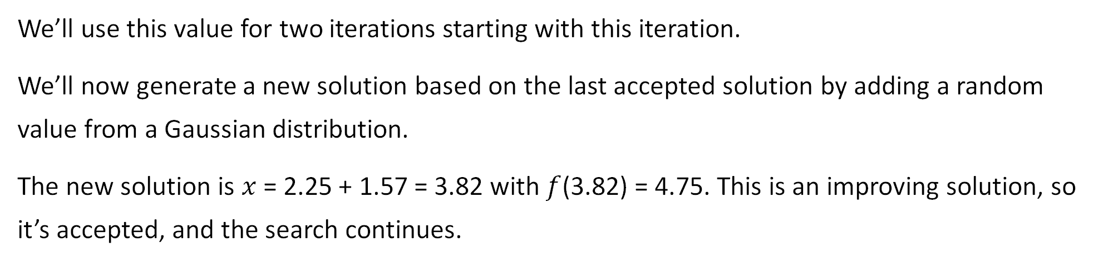
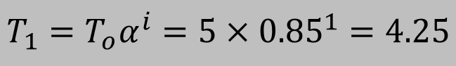
Function Optimization
Interation-3
We update the temperature because we have used the initial temperature$T0$ = 5 for two iterations so far. Following geometric cooling, the new temperature is
$$T_{1}=T_{o}α^{i}=5×{0.85}^{1}=4.25$$
We’ll use this value for two iterations starting with this iteration.
We’ll now generate a new solution based on the last accepted solution by adding a random value from a Gaussian distribution.
The new solution is $x$ = 2.25 + 1.57 = 3.82 with $f$(3.82) = 4.75. This is an improving solution, so it’s accepted, and the search continues.

Slide 47
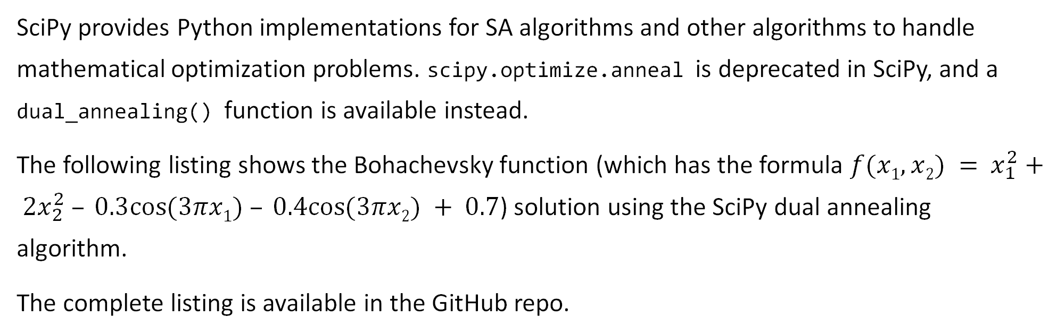
Function Optimization
Implementation
SciPy provides Python implementations for SA algorithms and other algorithms to handle mathematical optimization problems. scipy.optimize.anneal is deprecated in SciPy, and a dual_annealing() function is available instead.
The following listing shows the Bohachevsky function (which has the formula $f(x1,x2) =$ $x_{1}^{2}+ 2x_{2}^{2} – 0.3cos⁡(3πx1) – 0.4cos⁡(3πx2) + 0.7$) solution using the SciPy dual annealing algorithm.
The complete listing is available in the GitHub repo.

Slide 48
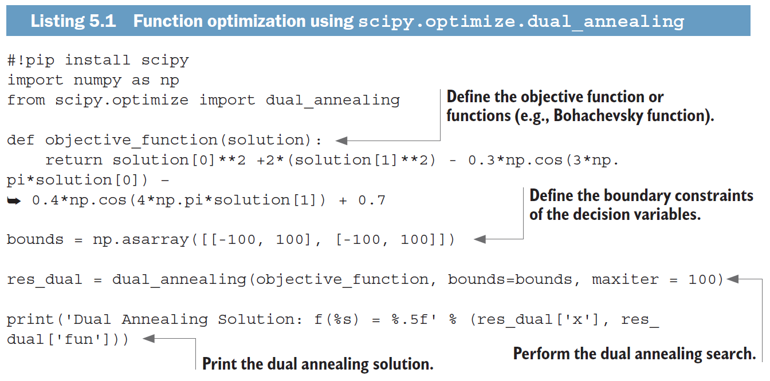
Function Optimization
Implementation

Slide 49

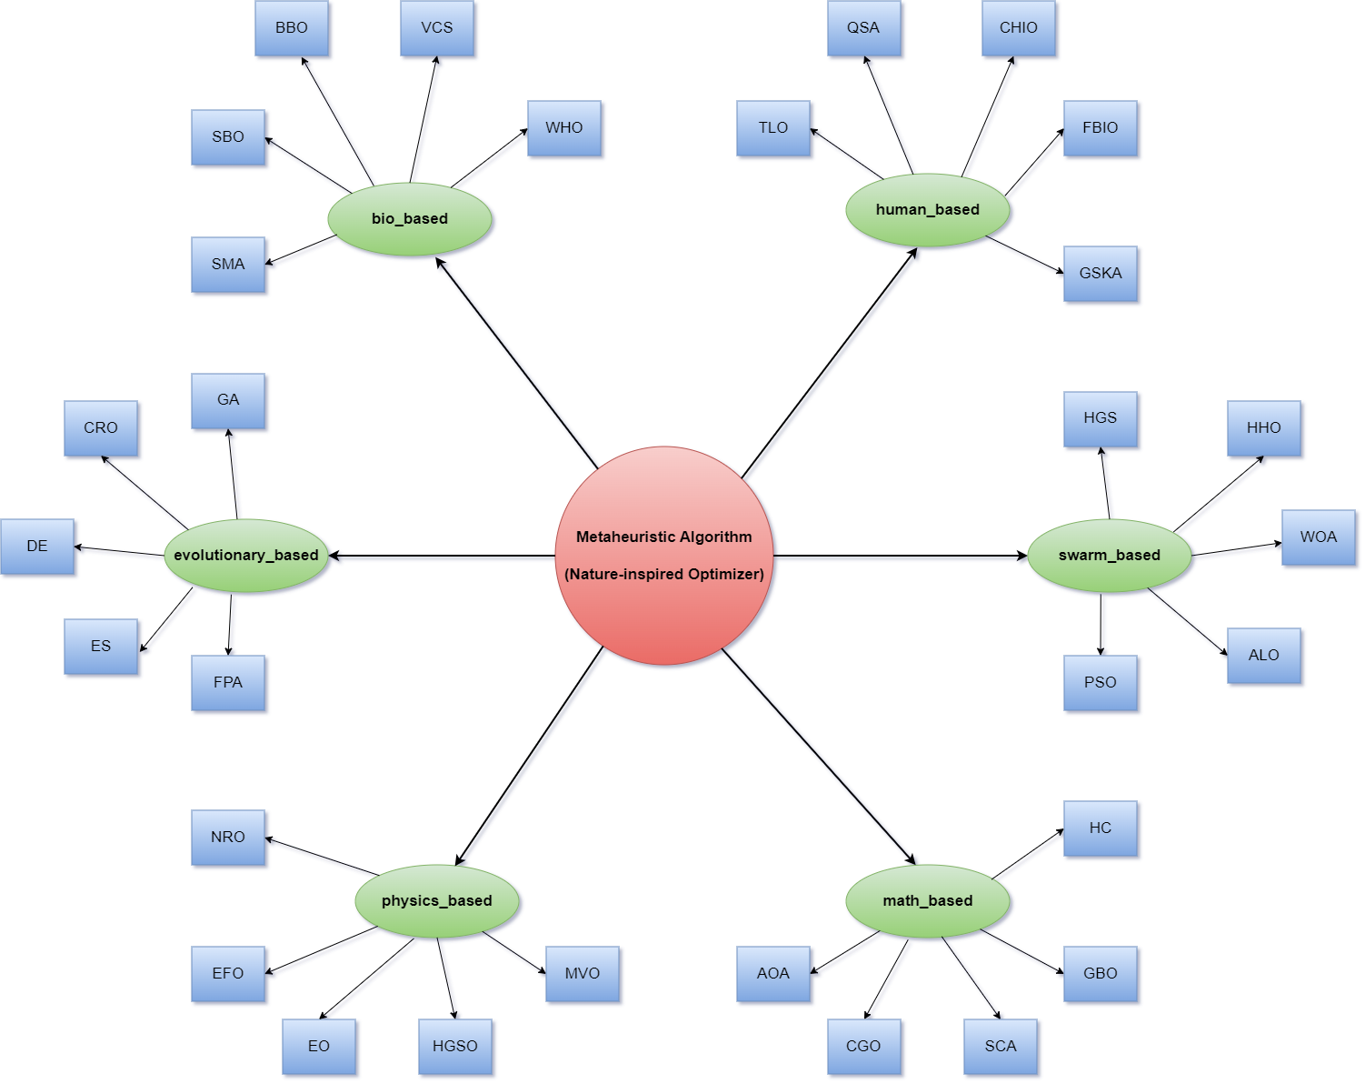
Function Optimization
Implementation
MEALPY is another Python library that provides implementations of different nature-inspired metaheuristic algorithms.
As a continuation, the following code shows the Bohachevsky function solution using MEALPY SA (the code is available in the GitHub repo)

Slide 50
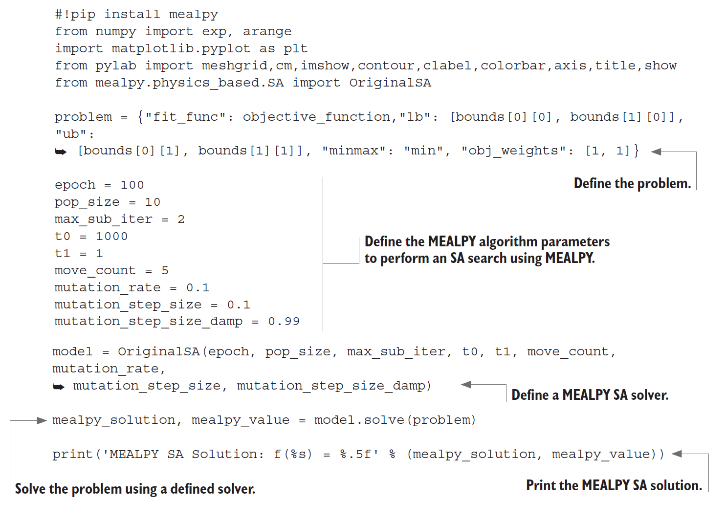
Function Optimization
Implementation

Slide 51
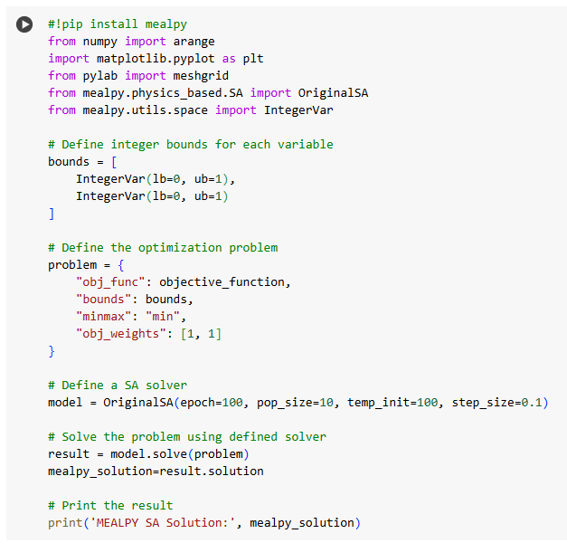
Function Optimization
Implementation
Code: https://colab.research.google.com/github/Dr-AlaaKhamis/ISE491/blob/main/3_Trajectory_algorithms/SA/FcnOpt.ipynb

Slide 52
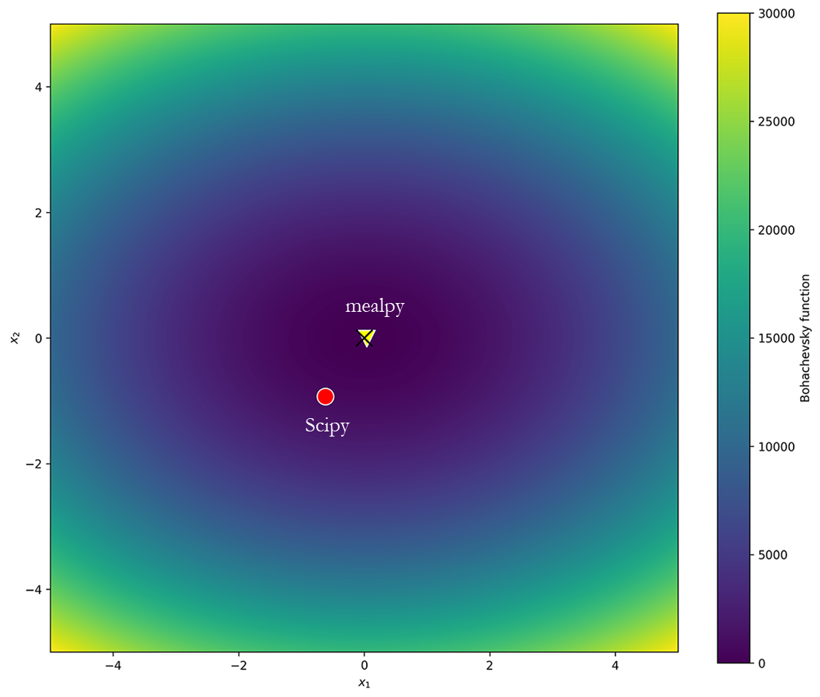
Function Optimization
Solution

Slide 53
Function Optimization
SA Implementation in Optalgotools
In our implementation, these are the SA parameters:
A maximum number of iterations: max_iter=1000
Maximum iterations per temperature: max_iter_per_temp=100
An initial temperature: initial_temp=1000
A final temperature: final_temp=0.0001
A cooling schedule: cooling_schedule='geometric' (available options: 'linear', 'geometric', 'logarithmic', 'exponential', 'linear_inverse')
A cooling factor: cooling_alpha=0.9
A debug option: debug=1 (debug=1 prints the initial and final solution; debug=2 provides hand-iteration tracing)

Slide 54
Function Optimization
SA Implementation in Optalgotools
We’ll use this implementation to solve the following problems:
A simple quadratic equation—This is what we used in the hand iterations.
The Bohachevsky function (global minimum 0)—This is a 2D unimodal function with a bowl shape.
The Bukin function—This function has many local minima. This function is continuous, convex, nonseparable, nondifferentiable, multimodal, nonrandom, and nonparametric. This requires a derivative-free solver (also known as a black-box solver) such as SA.
The Gramacy & Lee function—This is a 1D function with multiple local minima
and local and global trends.
The Griewank 1D, 2D, and 3D functions—These have many widespread local minima.

Slide 55
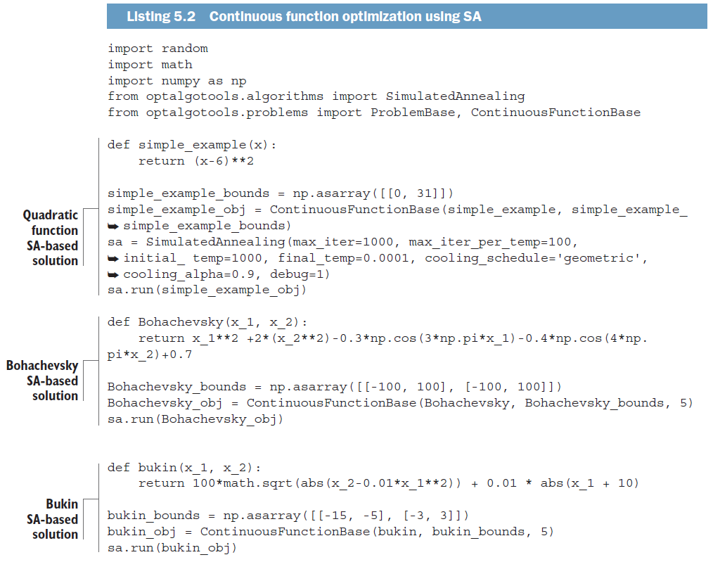
Function Optimization
SA Implementation in Optalgotools

Slide 56
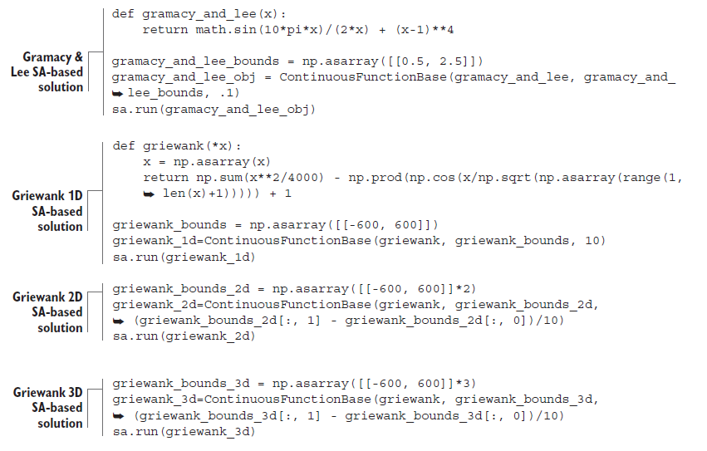
Function Optimization
SA Implementation in Optalgotools
This is an example of the output for the Bukin function:
Simulated annealing is initialized:
current value = 60.73784664253138, current temp=1000
Simulated Annealing is done:
curr iter: 154, curr best value: 0.6093437608551259, curr
temp:9.97938882337113e-05, curr best: sol: [-14.63282848 2.14122839]
global minimum: x = -14.6328, 2.1412, f(x) = 0.6093

Slide 57
Outline
Metaheuristics Algorithms
Physical Annealing
Simulated Annealing (SA)
SA Cooling Schedule
Adaptation in SA
NetLogo Model
Function Optimization
Solving Sudoku
Solving TSP
Solving Delivery Semi-Truck Routing Problem
SA for PLP
SA for Scheduling Problems
Notes:
57

Slide 58
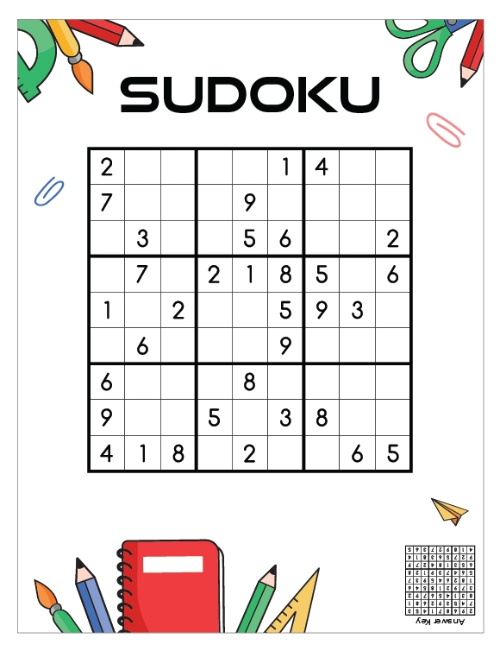
Solving Sudoku
Sudoku Game
The Sudoku game can be seen as a constraint-satisfaction problem (CSP) that is solved by correctly filling a 9 × 9 grid with digits so that:
each column, each row, and each of the nine 3 × 3 subgrids (aka “boxes,” “blocks,” or “regions”) contain all of the digits from 1 to 9.
any row or column or 3 × 3 subgrid shouldn’t contain more than one of the same number from 1 to 9.

Slide 59
Solving Sudoku
Solving Sudoku using Backtracking
Backtracking algorithms are commonly used to solve search and optimization problems by recursion.
The backtracking algorithm builds a feasible solution or a set of feasible solutions incrementally.
Given a 9 × 9 Sudoku board, the algorithm visits all the empty cells following depth-first traversal order, filling the digits incrementally, and it backtracks when a number is not found to be valid.

Slide 60
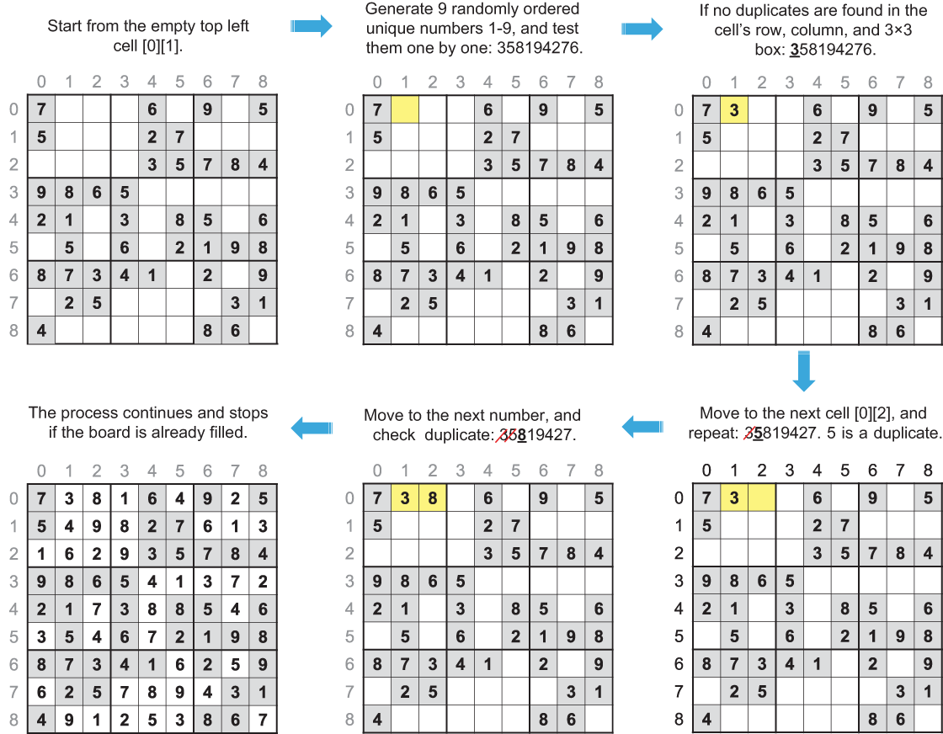
Solving Sudoku
Solving Sudoku using Backtracking

Slide 61
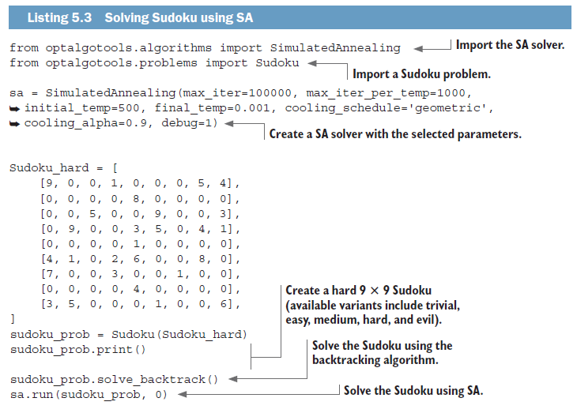
Solving Sudoku
Solving Sudoku using SA

Slide 62
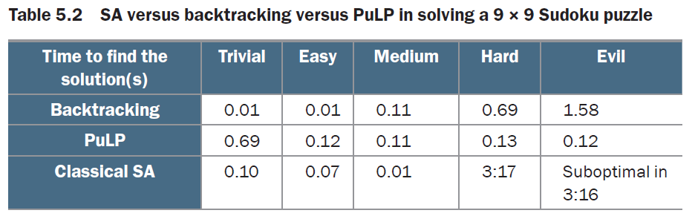
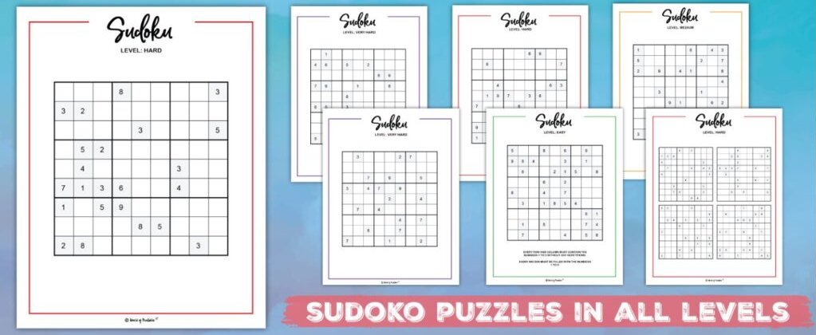
Solving Sudoku
Solving Sudoku using SA

Slide 63
Outline
Metaheuristics Algorithms
Physical Annealing
Simulated Annealing (SA)
SA Cooling Schedule
Adaptation in SA
NetLogo Model
Function Optimization
Solving Sudoku
Solving TSP
Solving Delivery Semi-Truck Routing Problem
SA for PLP
SA for Scheduling Problems
Notes:
63

Slide 64
Solving TSP
TSP Problem
Given n cities,
A travelling salesman must visit the n cities and return home, making a loop (roundtrip).
He would like to travel in the most efficient way (cheapest way or shortest distance or some other criterion).
Search Space
Search space is BIG:
for 14 cities there are (14-1)! ≈ 622,702,080 possible tours *. This is NP-hard problem.
*Fortunately, dynamic programming algorithms enable reduced complexity as explained in Chapter 2 of the textbook.
Notes:
64

Slide 65
Solving TSP
TSP Problem
1
4
TSP
2
3
Symmetric (STSP)
Asymmetric (ATSP)
In the symmetric TSP, the distance between two cities is the same in each opposite direction, forming an undirected graph. This symmetry halves the number of possible solutions.
In the asymmetric TSP, paths may not exist in both directions or the distances might be different, forming a directed graph. Traffic collisions, one-way streets, and airfares for cities with different departure and arrival fees are examples of how this symmetry could break down.
#routes=4!/2=12
#routes=(n-1)!=(4-1)!=6

Slide 66
Solving TSP
TSP Problem
Microchips manufacturing: manufacture of a circuit board, it is important to determine the best order in which a laser will drill thousands of holes.
Permutation flow shop scheduling problem (PFSP): consists of finding a sequence for the jobs that minimizes the makespan; that is, the overall time to complete the schedule.
TSP Applications
TSP is used as a platform for the study of general methods that can be applied to a wide range of discrete optimization problems
Overhauling of gas turbine engines
Transportation and Logistics
The problem of arranging school bus routes to pick up the children in a school district
Assignment of routes for planes of a specified fleet
Transportation of farming equipment from one location to another to test soil or scheduling of service calls at cable firms
The delivery of meals to homebound persons
The scheduling of stacker cranes in warehouses
The routing of trucks for parcel post pickup, and a host of others.
…

Slide 67
Solving TSP
Miller–Tucker–Zemlin (MTZ) Problem Formulation
In the complete directed graph D=(N,A), with arc-costs c_{ij} , we seek the tour (a directed cycle that contains all n cities) of minimal length.
i=2
2
c₁₂=4
c_{ij} =c₂₅=5
c₂₃=7
c₁₅=12
1
j=5
c₁₄=9
c₂₄=5
5
c₁₃=2
c₃₅=10
c₄₅=3
3
4
c₃₄=4

Slide 68
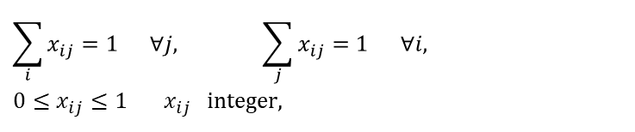
Solving TSP
Miller–Tucker–Zemlin (MTZ) Problem Formulation
The TSP can be defined as a minimization problem as follows:
i=2
2
c₁₂=4
c_{ij} =c₂₅=5
c₂₃=7
Subject to two types of constraints:
c₁₅=12
1
j=5
c₁₄=9
c₂₄=5
5
1. Assignment Constraints
c₁₃=2
c₃₅=10
c₄₅=3
$$\sum_{i}{x_{ij}=1 ∀j,} \sum_{j}{x_{ij}=1 ∀i,} \\ 0≤x_{ij}≤1 x_{ij} \text{integer}\text{,}$$
3
4
c₃₄=4

Slide 69
Solving TSP
Miller–Tucker–Zemlin (MTZ) Problem Formulation
2. Subtour (or subtour elimination) Constraints
To exclude subtours, one can use extra variables u_{i} (i = 1, . . . , n), and the constraints
Arc | Constraint | Validity
2-3 | 2-3+1≤(5-1)(1-1) | √
3-4 | 3-4+1≤(5-1)(1-1) | √
4-2 | 4-2+1≤(5-1)(1-1) | X

Slide 70
Solving TSP
The solution would be a permutation of n cities:
Sol = [ 1, 2, 3, .., n ]
We should define a neighborhood for the solution in order to generate the next one.
The new solution could be generated by performing a predetermined number of swaps on the current solution.
Some adaptive implementations decrease the number of cities to swap during the run. Thus, reducing the neighborhood size as the search progresses.

Slide 71
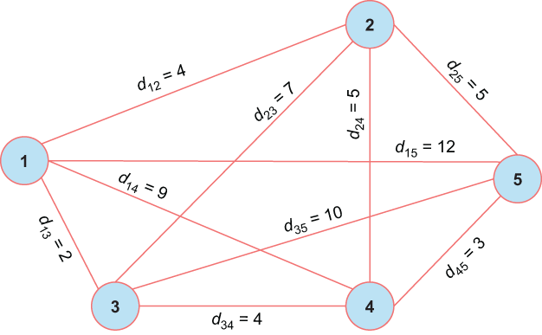
Solving TSP
Example: 5 cities – 120/2=60 possible tours (symmetric TSP)

Slide 72
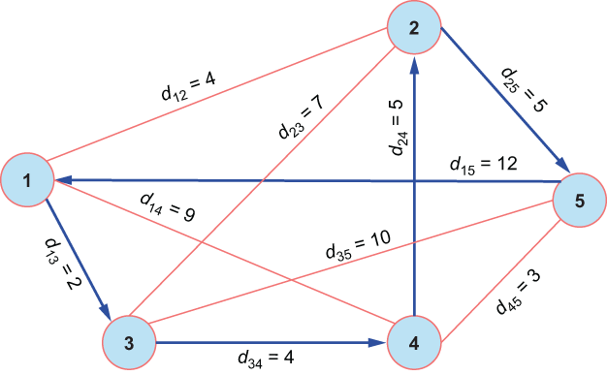
Solving TSP
Iteration-0 of 5-City TSP
Initial solution is Sol = [ 1, 3, 4, 2, 5], cost=2+4+5+5+12=28

Slide 73

Solving TSP
Iteration-1 of 5-City TSP
Select two random cities (for example 2 and 3) and swap them. This results in a new solution [ 1, 2, 4, 3, 5] with cost 35.
Calculate acceptance probability:
p=e^{-Δf/T}=e^{-(35-28)/T}= e^{-7/T}
Pick a random value r within 0 and 1.
If P>r, accept this solution. Otherwise reject this solution.

Slide 74

Solving TSP
Iteration-2 of 5-City TSP
Swapping cities 2 and 5 in the initial solution. The tour length of the candidate solution is 18.

Slide 75
Solving TSP
Since this solution has a shorter tour length, it will get accepted.
The search continues …

Slide 76

Solving TSP
Code: https://colab.research.google.com/github/Dr-AlaaKhamis/ISE491/blob/main/3_Trajectory_algorithms/SA/TSP.ipynb

Slide 77


Solving TSP
The SA was applied for the berlin52 TSP * instance by having:
Code: https://colab.research.google.com/github/Dr-AlaaKhamis/ISE491/blob/main/3_Trajectory_algorithms/SA/Berlin52.ipynb

Slide 78



Solving TSP
Saudi Tour
Code: https://colab.research.google.com/github/Dr-AlaaKhamis/ISE491/blob/main/3_Trajectory_algorithms/SA/SaudiTour.ipynb

Slide 79
Outline
Metaheuristics Algorithms
Physical Annealing
Simulated Annealing (SA)
SA Cooling Schedule
Adaptation in SA
NetLogo Model
Function Optimization
Solving Sudoku
Solving TSP
Solving Delivery Semi-Truck Routing Problem
SA for PLP
SA for Scheduling Problems
Notes:
79

Slide 80


Solving Delivery Semi-Truck Routing Problem
Given: Walmart Superstores in Ontario as points of interest (POI)
Required: find the shortest possible route the semi can follow to visit each POI only once starting from Walmart Supercenter #3001 located at 270 Kingston Rd E in Ajax.
POI Factory

Slide 81

Solving Delivery Semi-Truck Routing Problem
Code: https://github.com/Optimization-Algorithms-Book/Code-Listings/blob/main/Chapter%205/Listing%205.6_Walmart.ipynb

Slide 82

Solving Delivery Semi-Truck Routing Problem
Code: https://github.com/Optimization-Algorithms-Book/Code-Listings/blob/main/Chapter%205/Listing%205.6_Walmart.ipynb

Slide 83
Outline
Metaheuristics Algorithms
Physical Annealing
Simulated Annealing (SA)
SA Cooling Schedule
Adaptation in SA
NetLogo Model
Function Optimization
Solving Sudoku
Solving TSP
Solving Delivery Semi-Truck Routing Problem
SA for PLP
SA for Scheduling Problems
Notes:
83

Slide 84

SA for PLP
Plant Layout Problem (PLP)
The Plant Layout Problem (PLP) aims at assigning different facilities (departments) F to different locations L in order to minimize a given function cost, such as the total material handling cost.
Notes:
84

Slide 85

SA for PLP
Plant Layout Problem (PLP)
Assume that $ωij$ is the frequency of interaction or the flow of products between these departments and $df(i)f(j)$ is the distance between departments i and j.
The material handling cost (MHC) is
Notes:
85

Slide 86
SA for PLP
Plant Layout Problem (PLP)
and the total material handling cost (TMHC) is the summation of all the material handling costs inside the material handling cost matrix. In matrix notation, the problem can be formulated as
where $X$ represents the assignment vector, $W$ is the flow matrix, and $D$ is the distance matrix. Trace is the sum of elements on the main diagonal (from the upper left to the lower right) of the resultant material handling cost matrix.
Notes:
86

Slide 87
SA for PLP
Plant Layout Problem (PLP): Flow Matrix
Assume that the following flow matrix indicates the flow of products between the different facilities.
Flow Matrix
F | E | D | C | B | A
0 | 0 | 0 | 100 | 50 | 0 | A
90 | 100 | 25 | 35 | 0 | 0 | B
25 | 75 | 60 | 0 | 75 | 0 | C
25 | 100 | 0 | 50 | 50 | 0 | D
10 | 0 | 140 | 50 | 75 | 0 | E
0 | 0 | 0 | 0 | 0 | 0 | F
Notes:
87

Slide 88
SA for PLP
Plant Layout Problem (PLP): Distance Matrix
The distance matrix indicates the distances between the different locations.
Assuming that we’re moving only vertically or horizontally (No diagonal move). Assume also that if we have 2 paths, we take the shortest. The distance matrix in this case is as follows:
F | E | D | C | B | A
3 | 2 | 1 | 2 | 1 | 0 | A
2 | 1 | 2 | 1 | 0 | 1 | B
1 | 2 | 3 | 0 | 1 | 2 | C
2 | 1 | 0 | 3 | 2 | 1 | D
1 | 0 | 1 | 2 | 1 | 2 | E
0 | 1 | 2 | 1 | 2 | 3 | F
1 | 2 | 3
4 | 5 | 6
A
B
C
D
E
F
Notes:
88

Slide 89
SA for PLP
Plant Layout Problem (PLP): Example
It is required to allocate the six departments to the six locations to minimize the Total Material Handling Cost (TMHC).
Generate an initial solution.
Define a suitable neighborhood operator.
Define a suitable annealing schedule and perform 2 iterations of SA.
Notes:
89

Slide 90
SA for PLP
Initial Solution
1 | 2 | 3
4 | 5 | 6
A
B
C
6 | 5 | 4 | 3 | 2 | 1
F | E | D | C | B | A
D
E
F
Distance Matrix
F | E | D | C | B | A
3 | 2 | 1 | 2 | 1 | 0 | A
2 | 1 | 2 | 1 | 0 | 1 | B
1 | 2 | 3 | 0 | 1 | 2 | C
2 | 1 | 0 | 3 | 2 | 1 | D
1 | 0 | 1 | 2 | 1 | 2 | E
0 | 1 | 2 | 1 | 2 | 3 | F
Notes:
90

Slide 91
SA for PLP
Initial Solution
_{From}^{To} | A | B | C | D | E | F
A | 0 | 50 | 100 | 0 | 0 | 0
B | 0 | 0 | 35 | 25 | 100 | 90
C | 0 | 75 | 0 | 60 | 75 | 25
D | 0 | 50 | 50 | 0 | 100 | 25
E | 0 | 75 | 50 | 140 | 0 | 10
F | 0 | 0 | 0 | 0 | 0 | 0
Flow Matrix
Distance Matrix
MHC
Material Handling Cost=distance*flow
F | E | D | C | B | A
3 | 2 | 1 | 2 | 1 | 0 | A
2 | 1 | 2 | 1 | 0 | 1 | B
1 | 2 | 3 | 0 | 1 | 2 | C
2 | 1 | 0 | 3 | 2 | 1 | D
1 | 0 | 1 | 2 | 1 | 2 | E
0 | 1 | 2 | 1 | 2 | 3 | F
F | E | D | C | B | A
0 | 0 | 0 | 200 | 50 | 0 | A
180 | 100 | 50 | 35 | 0 | 0 | B
25 | 150 | 180 | 0 | 75 | 0 | C
50 | 100 | 0 | 150 | 100 | 0 | D
10 | 0 | 140 | 100 | 75 | 0 | E
0 | 0 | 0 | 0 | 0 | 0 | F
Notes:
91

Slide 92
SA for PLP
Initial Solution
6 | 5 | 4 | 3 | 2 | 1
F | E | D | C | B | A
MHC
Subtotal | F | E | D | C | B | A
250 | 0 | 0 | 0 | 200 | 50 | 0 | A
365 | 180 | 100 | 50 | 35 | 0 | 0 | B
430 | 25 | 150 | 180 | 0 | 75 | 0 | C
400 | 50 | 100 | 0 | 150 | 100 | 0 | D
325 | 10 | 0 | 140 | 100 | 75 | 0 | E
0 | 0 | 0 | 0 | 0 | 0 | 0 | F
Total Material Handling Cost (TMHC)=1770
Notes:
92

Slide 93
SA for PLP
Neighboring Solution
Swapping can be used as a neighborhood operator to generate feasible neighboring solution
Current:
6 | 5 | 4 | 3 | 2 | 1
F | E | D | C | B | A
New:
6 | 5 | 4 | 3 | 2 | 1
F | E | B | C | D | A
Notes:
93

Slide 94
SA for PLP
Annealing Schedule
Initial temperature (T_{o})=100
Final temperature (T_{f})=0.01
Temperature Decay ⇒ Geometric T=T₀α^{i}
where α=0.85, i is iteration index.
Iteration at each temperature=2
Notes:
94

Slide 95
SA for PLP
Iteration-1 (T₀=100)
Initial Solution:
6 | 5 | 4 | 3 | 2 | 1
F | E | D | C | B | A
Cost=1770
Neighboring Solution:
6 | 5 | 4 | 3 | 2 | 1
F | E | B | C | D | A
1 | 2 | 3
4 | 5 | 6
A
D
C
F | E | D | C | B | A
3 | 2 | 1 | 2 | 1 | 0 | A
2 | 1 | 2 | 3 | 0 | 1 | B
1 | 2 | 1 | 0 | 3 | 2 | C
2 | 1 | 0 | 1 | 2 | 1 | D
1 | 0 | 1 | 2 | 1 | 2 | E
0 | 1 | 2 | 1 | 2 | 3 | F
B
E
F
Distance Matrix
Notes:
95

Slide 96
SA for PLP
Iteration-1 (T₀=100)
Neighboring Solution:
6 | 5 | 4 | 3 | 2 | 1
F | E | B | C | D | A
MHC
Subtotal | F | E | D | C | B | A
250 | 0 | 0 | 0 | 200 | 50 | 0 | A
435 | 180 | 100 | 50 | 105 | 0 | 0 | B
460 | 25 | 150 | 60 | 0 | 225 | 0 | C
300 | 50 | 100 | 0 | 50 | 100 | 0 | D
415 | 10 | 0 | 280 | 50 | 75 | 0 | E
0 | 0 | 0 | 0 | 0 | 0 | 0 | F
Total Material Handling Cost (TMHC)=1860
Since the cost is not improved, we have to use transition probability.
Notes:
96

Slide 97
SA for PLP
Transition Probability
Assume randomly generated number r=0.2
Since p>r then accept the non-improving solution…
Notes:
97

Slide 98
SA for PLP
Iteration-2
Current Solution:
6 | 5 | 4 | 3 | 2 | 1
F | E | B | C | D | A
Cost=1860
Neighboring Solution:
6 | 5 | 4 | 3 | 2 | 1
F | E | B | C | A | D
1 | 2 | 3
4 | 5 | 6
D
A
C
F | E | D | C | B | A
2 | 1 | 1 | 2 | 2 | 0 | A
2 | 1 | 1 | 3 | 0 | 2 | B
1 | 2 | 2 | 0 | 3 | 1 | C
3 | 2 | 0 | 2 | 1 | 1 | D
1 | 0 | 2 | 2 | 1 | 1 | E
0 | 1 | 3 | 1 | 2 | 2 | F
B
E
F
Distance Matrix
Notes:
98

Slide 99
SA for PLP
Iteration-2
Neighboring Solution:
6 | 5 | 4 | 3 | 2 | 1
F | E | B | C | A | D
MHC
Subtotal | F | E | D | C | B | A
200 | 0 | 0 | 0 | 100 | 100 | 0 | A
410 | 180 | 100 | 25 | 105 | 0 | 0 | B
520 | 25 | 150 | 120 | 0 | 225 | 0 | C
425 | 75 | 200 | 0 | 100 | 50 | 0 | D
465 | 10 | 0 | 280 | 100 | 75 | 0 | E
0 | 0 | 0 | 0 | 0 | 0 | 0 | F
Total Material Handling Cost (TMHC)=2020
Since the cost is not improved, we have to use transition probability.
Notes:
99

Slide 100
SA for PLP
Iteration-2
Assume randomly generated number r=0.6
Since p<r then reject the non-improving solution…
Notes:
100

Slide 101
SA for PLP
Iteration-2
Best solution so far is:
6 | 5 | 4 | 3 | 2 | 1
F | E | B | C | D | A
Cost=1860
Temperature update after 2 iterations:
Notes:
101

Slide 102
Outline
Metaheuristics Algorithms
Physical Annealing
Simulated Annealing (SA)
SA Cooling Schedule
Adaptation in SA
NetLogo Model
Function Optimization
Solving Sudoku
Solving TSP
Solving Delivery Semi-Truck Routing Problem
SA for PLP
SA for Scheduling Problems
Notes:
102

Slide 103
SA for Scheduling Problems
Job shop scheduling (or job-shop problem) addresses how to schedule jobs to be processed on machine(s).
Alaa Khamis, (56-10569): Industrial Automation II, 2005-2006, Department of Systems Engineering and Automation, Charles III University of Madrid.
Notes:
103

Slide 104
SA for Scheduling Problems
In Job shop scheduling problem (JSSP), n jobs J₁, J₂, ..., J_{n} of varying sizes are given. These jobs need to be scheduled on m machines, while trying to minimize the makespan.
The makespan is the total length of the schedule (that is, when all the jobs have finished processing). It is the completion time of the last job.
Notes:
104

Slide 105


SA for Scheduling Problems
Two Machine - Three Jobs Example
Single Machine: Only one machine is available to process jobs. Each job has a single task. Every job is performed on the same machine.
Parallel Machines: Multiple machines are available to process jobs. The machines can be identical, of different speeds, or specialized to only processing specific jobs. Each job has a single task.
M
j₁
j₂
…
j_{n}
M₁
j₁
j₂
M₁
j₃
…
M_{m}
….
j_{n}
Notes:
105

Slide 106
SA for Scheduling Problems
Two Machine - Three Jobs Example
There are three parts, P₁, P₂, and P₃. Each needs to be processed first on Machine M₁, then on Machine M₂.
Machines | Parts
 | P1 | P2 | P3
M1 | 6 | 2 | 8
M2 | 4 | 4 | 4
There are 6 possible sequences for the parts:
1-2-3, 1-3-2, 2-1-3, 2-3-1, 3-1-2, and 3-2-1
For any sequence, Machine 1 will start working at T=0, and work till T= 6+2+8 = 16.
Notes:
106

Slide 107
SA for Scheduling Problems
Two Machine - Three Jobs Example
0
2
8
16
20
Time
M1 | P2 | P1 | P3
M2
Utilization of M2:
It will not work at the initial period when M1 is doing its first scheduled job. This hints that we should try to do the shortest job on M1 first!
Notes:
107

Slide 108
SA for Scheduling Problems
Two Machine - Three Jobs Example
0
2
8
16
20
Time
M1 | P2 | P1 |  | P3
M2 |  | P2
Utilization of M2 (cont’d):
What happens if the second operation (operation on M2) for a part is very short ? In this case, M2 will finish this part, while M1 is still working on the first operation of the next part. This will make M2 idle for some time. This hints that we should try to place jobs that have LONG 2nd operations in the beginning.
Notes:
108

Slide 109
SA for Scheduling Problems
Two Machine - Three Jobs Example
Gantt-chart
0
2
8
16
20
Time
M1 | P2 | P1 |  | P3
M2 |  | P2 |  | P1 |  | P3
M2 will always be idle for this duration
If Operation 2 of P2 (first job) is shorter than this duration, M2 will be idle by the duration shown in yellow
Makespan
(the time between the moment you start the first Job, till the time you end the last Job)
Notes:
109

Slide 110
SA for Scheduling Problems
Objective Functions
Makespan
Machine Utilization
Total (Weighted) Completion Time
Lateness
Tardiness
Notes:
110

Slide 111
SA for Scheduling Problems
Objective Functions: Makespan
Let C_{i} denote the completion time of the i^{th} job in a batch of n jobs given. The makespan, C_{max}, is defined as,
C_{max} = max (C₁, C₂, … , C_{n})
The makespan is the completion time of the last job.
A common problem of interest is to minimize C_{max},
This criterion is usually used to measure the level of utilization of the machine.
Notes:
111

Slide 112
SA for Scheduling Problems
Objective Functions: Machine Utilization
Machine utilization reflects the ratio between available and required machine capacity.
For a manufacturing company, it is usually desirable that machine idle times are kept as small as possible. The average machine utilization MU can be computed as
where n=number of jobs, m=number of machines and p_{ik}=processing time.
Notes:
112

Slide 113
SA for Scheduling Problems
Objective Functions: Total Completion Time
Let C_{i} denote the completion time of the i^{th} job in a batch of n jobs given. The total completion time is defined as,
The total completion time is the sum of all the completion times of the jobs. It is commonly referred to as the flow time.
Notes:
113

Slide 114
SA for Scheduling Problems
Objective Functions: Total (Weighted) Completion Time
It may be advisable to rank jobs according to their importance or order value. For this purpose, a non-negative weight value w_{i} has to be assigned to each job. In the default case, all weights w_{i} are chosen equal to 1.
Let w_{i} denote the weight assigned to the i^{th} job in the a batch of n jobs given. The total weighted completion time is defined as,
A common problem is in minimizing the total (weighted) completion time. This problem allows one to find an indication to the total holding or inventory caused by the schedule.
Notes:
114

Slide 115
SA for Scheduling Problems
Objective Functions: Lateness
Difference between completion time and the due date. L_{i}=C_{i}-d_{i}
where C_{i} is the completion of job i and d_{i} is the due date of job i.
Some of the problems involving lateness are:
1. Minimizing the total lateness. The total lateness is defined as,
Notes:
115

Slide 116
SA for Scheduling Problems
Objective Functions: Lateness
2. Minimizing the total weighted lateness. Let w_{i} denote the weight assigned to the i^{th} job. The total weighted lateness is defined as,
3. Minimizing the maximum lateness, L_{max}. L_{max} is defined as,
Notes:
116

Slide 117
SA for Scheduling Problems
Objective Functions: Tardiness
The tardiness of job i, T_{i}, is defined as
T_{i}=max (0, C_{i}-d_{i}) =max (0, L_{i})
where
C_{i} is the completion of job i and
d_{i} is the due date of job i.
Some of the problems involving tardiness are:
1. Minimizing the maximum tardiness
Notes:
117

Slide 118
SA for Scheduling Problems
Objective Functions: Tardiness
2. Minimizing the number of tardy jobs. The number of tardy jobs is defined as,
where δ(x) = 1 if x > 0
δ(x) = 0 otherwise
3. Minimizing the total weighted tardiness. Let w_{i} denote the weight assigned to the i^{th} job. The total weighted tardiness is defined as,
Notes:
118

Slide 119
SA for Scheduling Problems
Example-1: Single machine, minimize total weighted tardiness
 | Jobs | 1 | 2 | 3 | 4
Processing | p_{i} | 9 | 9 | 12 | 3
Due | d_{j} | 10 | 8 | 5 | 28
Weight | w_{j} | 14 | 12 | 1 | 12
Let an initial solution be 3, 1, 4, 2
p₃
p₁
p₄
p₂
time
0
12
21
24
33
∑w_{j}T_{j} = 1·max(0, (12-5)) + 14·max(0, (21-10)) +
12·max(0,(24-28))+ 12 ·max(0,(33-8) = 461
Notes:
119

Slide 120
SA for Scheduling Problems
Example-1: SA
 | Jobs | 1 | 2 | 3 | 4
Processing | p_{i} | 9 | 9 | 12 | 3
Due | d_{j} | 10 | 8 | 5 | 28
Weight | w_{j} | 14 | 12 | 1 | 12
Neighborhood by swapping the order of jobs. Select one at random
Use geometric temperature reduction: α=0.9, T_{o} =0.9
Set number of iterations at the same temperature=2
Notes:
120

Slide 121
SA for Scheduling Problems
Example-1: SA – Iteration 1
Initial solution: 3, 1, 4, 2 f=461
Consider the following neighbor: 1, 3, 4, 2
∑w_{j}T_{j} = 14.max(0,(9-10))+1.max(0,(21-5))+
12.max(0,(24-28)+12.max(0,(33-8))=316
Δf = -145
then we accept the new solution as it is improving.
Jobs | 1 | 2 | 3 | 4
$$pj$$ | 9 | 9 | 12 | 3
$$dj$$ | 10 | 8 | 5 | 28
$$wj$$ | 14 | 12 | 1 | 12
Notes:
121

Slide 122
SA for Scheduling Problems
Example-1: SA – Iteration 2
Current solution: 1, 3, 4, 2 f= 316
Generate a neighbor (say): 1, 4, 3, 2
∑w_{j}T_{j} = 14.max(0,(9-10))+12.max(0,(12-28))+
1.max(0,(24-5)+12.max(0,(33-8)) = 319
Δf = +3 i.e not-improving, apply the acceptance criteria.
Calculate p= e^{-Δf/T}= e^{-(319-316)/0.9}= 0.035
Generate a random number r between (0,1), say it was r=0.01
p>r then we accept the solution.
Jobs | 1 | 2 | 3 | 4
$$pj$$ | 9 | 9 | 12 | 3
$$dj$$ | 10 | 8 | 5 | 28
$$wj$$ | 14 | 12 | 1 | 12
Notes:
122

Slide 123
SA for Scheduling Problems
Example-1: SA – Iteration 2
Current solution: 1, 3, 4, 2 f= 316
Generate a neighbor (say): 1, 4, 3, 2
Update the temperature after these two iterations using geometric cooling:
T=T₀α^{i}, T= 0.9x0.9=0.81
search continues…
Notes:
123

Slide 124
SA for Scheduling Problems
Example-2: Multiple Machines Minimum Makespan Problem
Given processing times for n jobs, p1, p2, . . . , pn, and an integer m, the Minimum Makespan Scheduling problem is to find an assignment of the jobs to m machines, M1,M2, . . . ,Mm so that the final completion time (the makespan) is minimized.
M₁
p₁
p₂
M₁
p₃
…
M_{m}
….
p_{n}
Notes:
124

Slide 125
SA for Scheduling Problems
Example-2: 3 Machines – 6 Jobs Problem
6 jobs with processing times:p₁,p₂,p₃,p₄,p₅,p₆= (2,3,4,6,2,2)
3 machines m₁,m₂, m₃.
All machines should be assigned jobs.
Notes:
125

Slide 126
SA for Scheduling Problems
Example-2: 3 Machines – 6 Jobs Problem
Processing time: P=(2,3,4,6,2,2)
Consider the following schedule, we can code this schedule as (1,1,2,2,3,3) indicating machine assigned to the corresponding jobs.
M₁ | J₁₂ | J₂₃
M₂ | J₃₄ |  |  | J₄₆
M₃ | J₅₂ |  | J₆₂
time
Gantt-chart
Makespan=10
Notes:
126

Slide 127
SA for Scheduling Problems
Example-2: Generating Neighbors
We can consider permutation of the machines numbers for the 6 jobs, e.g (1,1,1,1,2,3), (1,1,1,2,1,3),……
There are a bit less than 3⁶ as we excluding unassigned machines.
Notice that swap operation from the initial solution doesn’t cover feasible solutions.
Notes:
127

Slide 128
SA for Scheduling Problems
Example-2: SA
Select a permutation at random
Use geometric temperature reduction α=.9, T_{o}=0.9
Set no. of iterations at the same temperature=2
Notes:
128

Slide 129
SA for Scheduling Problems
Example-2: Iteration 1
Initial Solution: (1,1,2,2,3,3) , Makespan=10
Consider the following neighbor: (1,1,1,1,2,3) for p(2,3,4,6,2,2) will produce a makespan of 15 which is worse than the initial solution.
Calculate p= e^{-Δf/T}= e^{-(15-10)/0.9}= 0.0004
Generate a random number r between (0,1), say it was r=0.2
P<r so we reject the solution.
Notes:
129

Slide 130
SA for Scheduling Problems
Example-2: Iteration 2
Current Solution: (1,1,2,2,3,3) , Makespan=10
Generate another neighbor, say (1,2,3,1,2,3) with makespan of 8.
This is an improvement of the current solution so we accept it.
And so on.
Optimal makespan for this problem is 7.
Notes:
130

Slide 131

SA for Scheduling Problems
Python Implementation
Code: https://github.com/Dr-AlaaKhamis/ISE491/blob/main/3_Trajectory_algorithms/SA/JSS_SA.ipynb
Notes:
131

